Slide 1
INVESTMENT CASE STUDY SUBMISSION
Group Name:
Deepak Aneja
Fayiz Mayamveettil
Merin Jose
Suresh Balla

Slide 2
Understanding Global Trends in Investments
Business Scenario
Spark Funds has a budget of 5 to 15million USD to be invested in a few companies which are based out of an English speaking country.
The overall strategy is to invest where others are investing, implying that the best sectors and countries are the ones where most investments are happening.

Slide 3
Problem solving methodology
Get the average investment for each investment type (venture, angel, seed, and private equity) and choose the best one as per the budget
Identify the best sector within selected countries for preferred investment type based on previous analysis and for 5 – 15 M budget
Understand the datasets
Clean the datasets
Identify the top countries which received most funding based on the above chosen investment type
Understand the keys and relation between data sets
Based on the analysis, arrive at a conclusion
Identify the top three English speaking countries
Start the Analysis

Slide 4
Funding Type Analysis
59.60% of the total amount invested globally is on Venture Type Investment
On slicing further on Angel, Seed, private equity and Venture, 78.38% out of these four are of Venture type.
The average investment amount required for venture is 11.75M
The average investment lies between 5 to 15M which is the available budget
Investment Type | Average Investment
Venture | $11,748,949.10
Angel | $958,694.50
Seed | $719,818
Private Equity | $73,308,593

Slide 5
Country Analysis
In terms of countries, below are the two main criteria
Invest in one of the most heavily invested countries
Invest in an English speaking country
The top three English Speaking Countries as below:
United States of America
United Kingdom of Great Britain and Northern Ireland
India
*Considering United Kingdom of Great Britain and Northern Ireland as native English speakers

Slide 6
Sector Analysis
For Selected Investment type Venture and Top 3 English speaking countries and a funding of 5 to 15 M, best sectors to invest was identified based on the number of investment on each sector for each country.
The observations are as below:
While “Cleantech / Semiconductors” are 3rd preferred sector for US and UK, for India 3rd Preferred sector is “News, Search and Messaging”
Country | Sector | No.of Investments
United States of America | Others | 2950
 | Social, Finance, Analytics, Advertising | 2714
 | Cleantech / Semiconductors | 2350
United Kingdom of Great Britain and Northern Ireland | Others | 147
 | Social, Finance, Analytics, Advertising | 133
 | Cleantech / Semiconductors | 130
India | Others | 110
 | Social, Finance, Analytics, Advertising | 60
 | News, Search and Messaging | 52

Slide 7
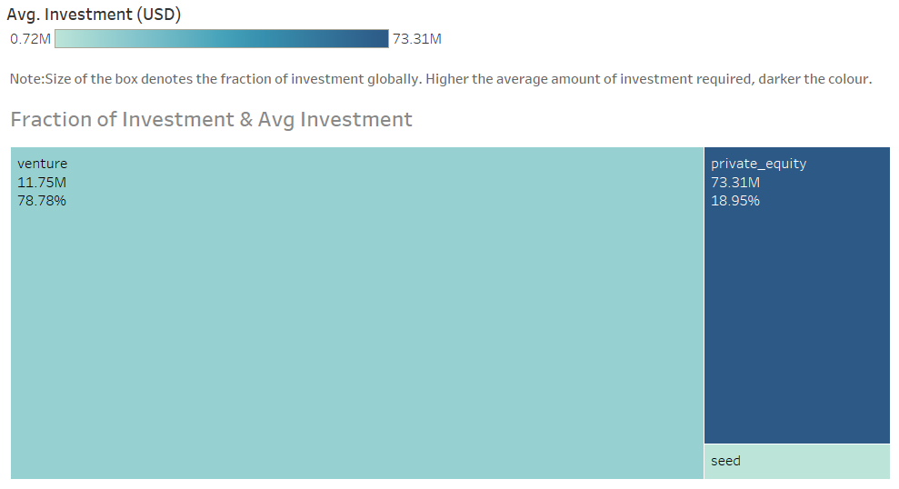
Investment Type Analysis

Slide 8
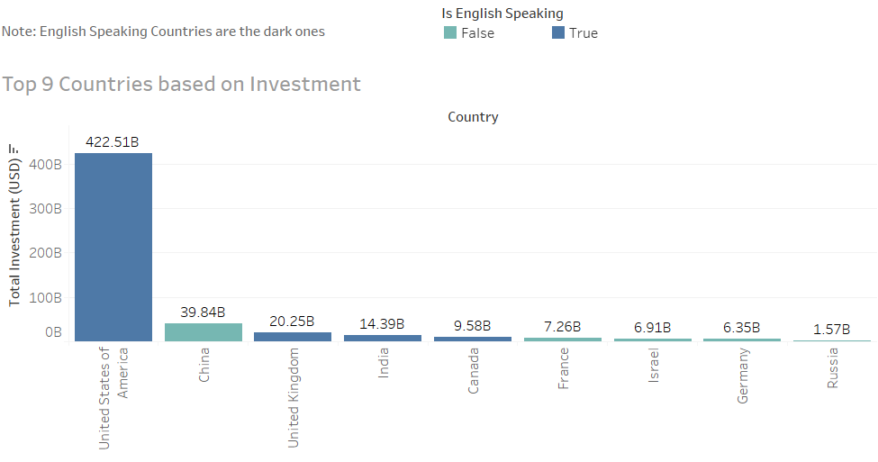
Top 9 Countries Based on Investment

Slide 9
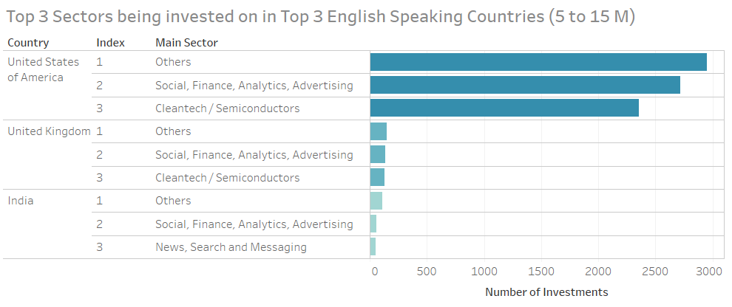
Top 3 English Speaking Countries and its Top 3 Sectors

Slide 10
Conclusion
Spark Funds should invest in Ventures
Highest Invested countries USA, UK or India should be Preferred
“Others”, “Social, Finance, Analytics, Advertising” are preferred sector for all three countries.
“Cleantech / Semiconductors” are 3rd preferred sector for US and UK and for India 3rd Preferred sector is “News, Search and Messaging”

